Slide 1
EXCAVATOR INCIDENT ON 22 SEP 2009 [Prompted the introduction of blue coloured road cones adj to and beneath overhead structures to provide a visual reminder of the fixed hazard above] MVM M1 widening J25-28 scheme

Slide 2
Incident summary
On Tuesday 22 September 2009 - The Driver/Operator of an Hydraulic Wheeled Excavator sustained a Fractured Skull and a collapsed Lung after he was ejected through the front of the Cab of the Excavator, on the MVM M1 widening J25-28 Project

Slide 3
What happened (Slide 1 of 2)
The Excavator had been travelling between Two Gantry Base locations along the Project’s Central Reserve work area, with the Excavator’s Dipper Arm in a raised position, the top of which was measured (post incident) at 6.50m above ground level
As the Excavator reached the 1st existing Motorway Over-bridge, the top of the Dipper Arm struck the edge of the Soffit of the Bridge causing the Excavator to come to a sudden halt.
The point of impact on the soffit of the Motorway Over-bridge was measured (post incident) at 6.15m above ground level (see photographs on following slides)

Slide 4
What happened (Slide 2 of 2)
The Driver/Operator (abbr. IP) was thrown forwards, over the Floor Mounted Steering Column and through the front of the Cab of the Excavator. The front of the Cab was open, and the window was in a raised position. He was not wearing his lap restraint.
IP came to rest with his Head face down, his Left Arm beneath his Torso and his Feet in a raised position between the Cab and Front Blade adjacent to the Excavator’s near side Front (Rubber) Wheel
From his seated position in the Cab, the IP was thrown forward and dropped vertically 1.75m hitting the top edge of the Excavator’s front Blade

Slide 5
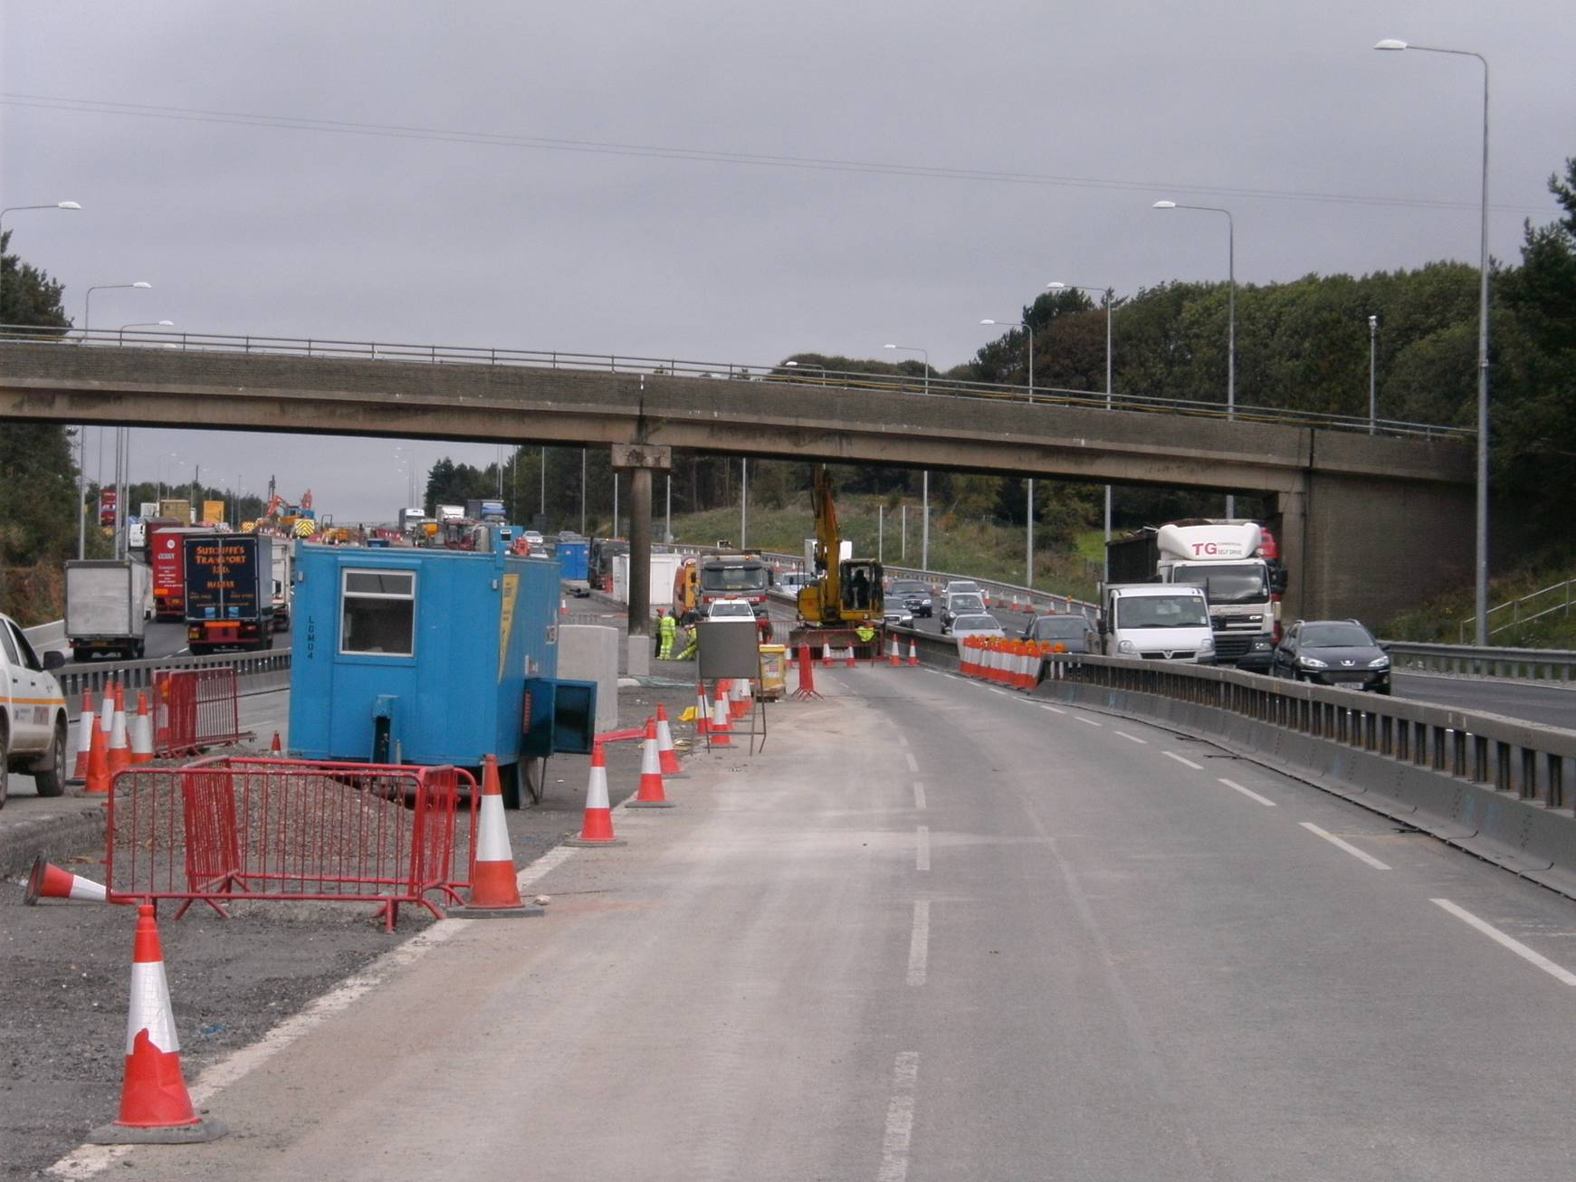
Photo taken during the investigation process to record / show position of the Excavator and dipper arm at the point of impact
Excavator incident, 22 Sep 09
Notes:
Photo taken during the investigation process to record / show position of the Excavator and dipper arm at the point of impact prior to removal from site

Slide 6
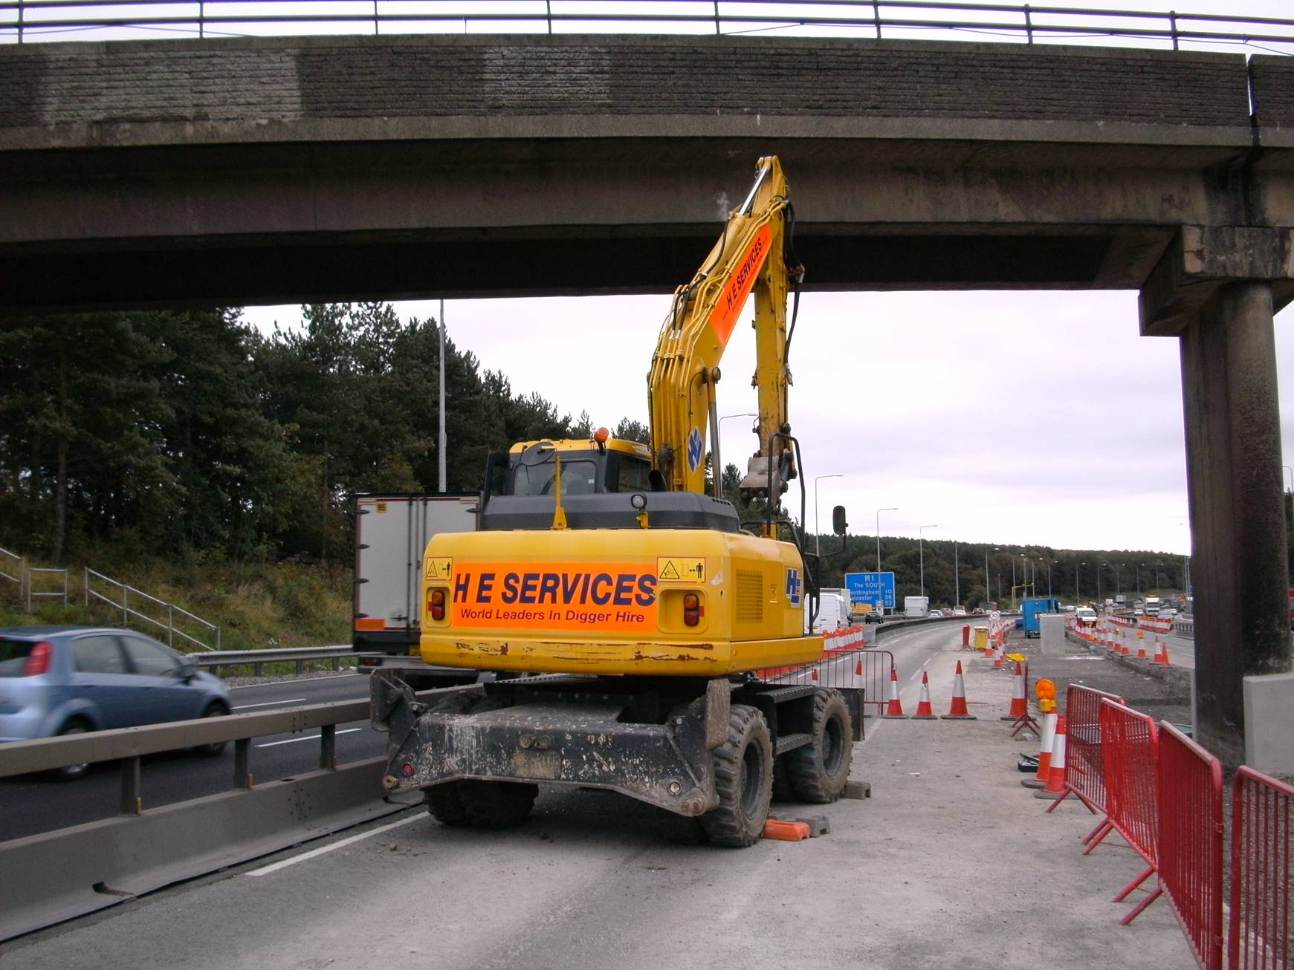
Photo taken during the investigation process to record / show position of the Excavator and dipper arm at the point of impact
Excavator incident, 22 Sep 09
Notes:
Photo taken during the investigation process to record / show position of the Excavator and dipper arm at the point of impact prior to removal from site

Slide 7
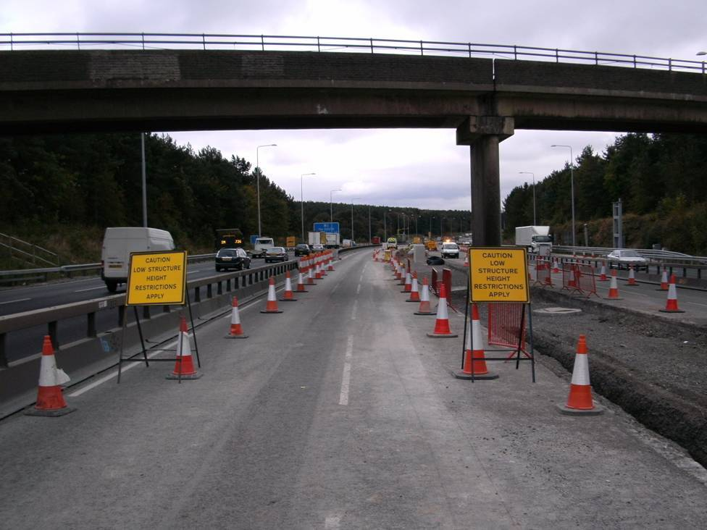
BEFORE - OH protection in place prior to the
excavator incident - 22 Sep 09
Notes:
Photo taken to show temp TM and signage in place adj to and beneath OH structures prior to the incident

Slide 8
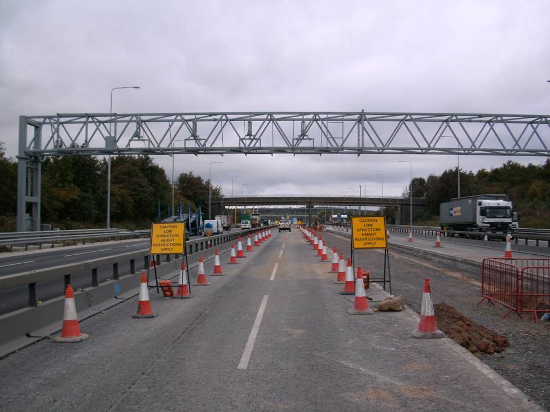
BEFORE - OH protection in place prior to the
excavator incident - 22 Sep 09
Notes:
Photo taken to show temp TM and signage in place adj to and beneath OH structures prior to the incident

Slide 9
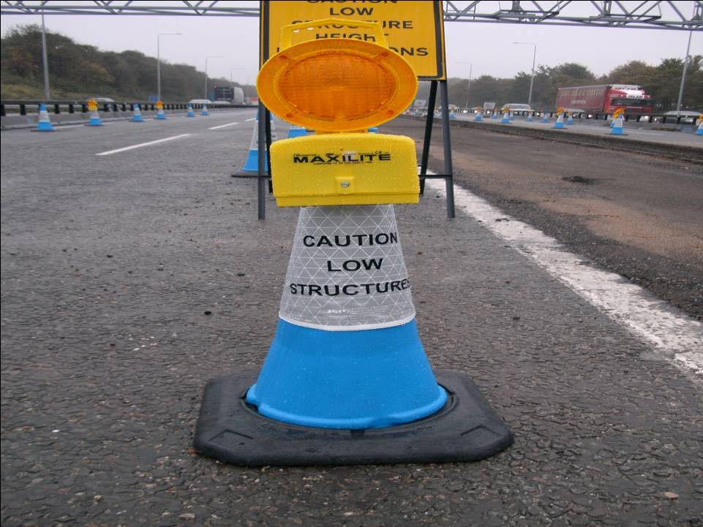
AFTER - OH protection in place in Oct-09
Showing blue coloured road cones, and signage, in place
Notes:
Photo taken to show temp TM and signage in place adj to and beneath OH structures, post incident, following introduction of blue coloured road cones with white sleeve (c/w “caution low structure” text)

Slide 10
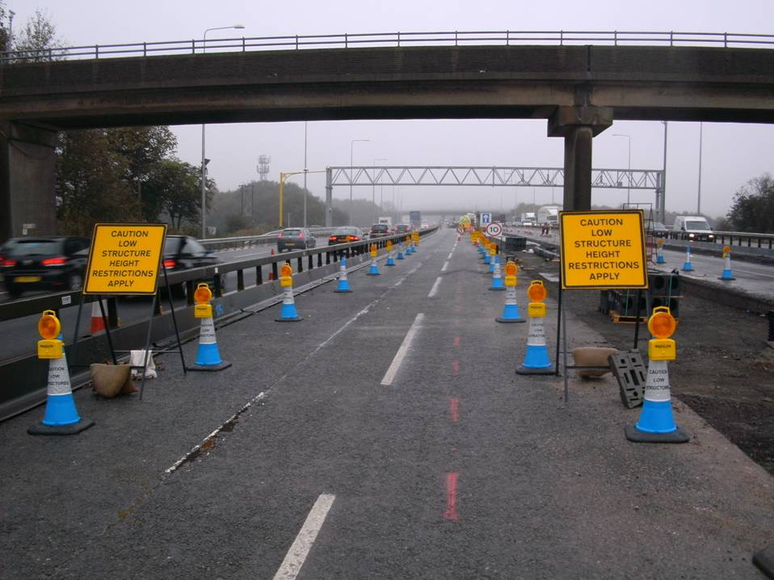
AFTER - OH protection in place in Oct-09
Showing blue coloured road cones, and signage, in place
Notes:
Photo taken to show temp TM and signage in place adj to and beneath OH structures, post incident, following introduction of blue coloured road cones with white sleeve (c/w “caution low structure” text)

Slide 11
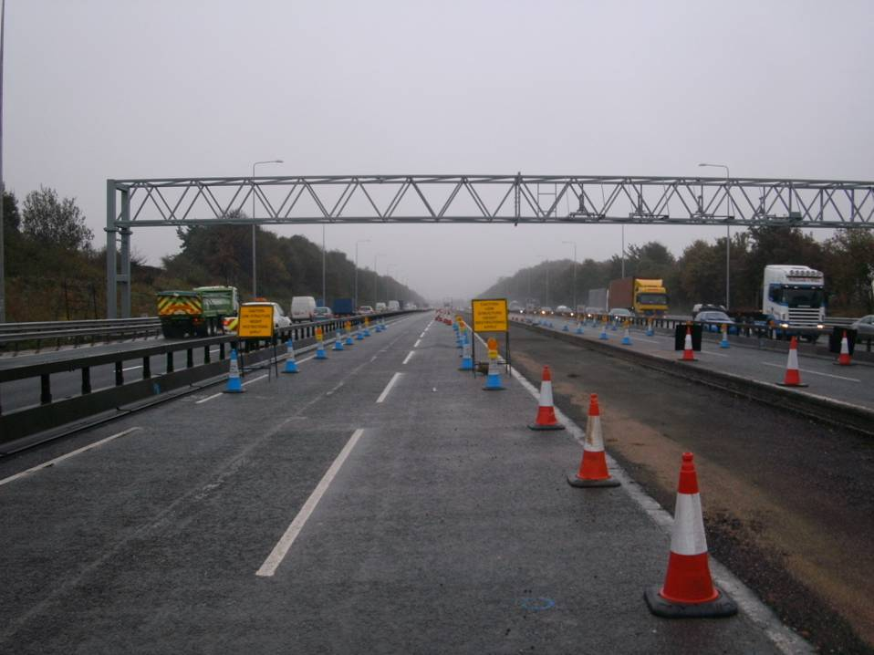
AFTER - OH protection in place in Oct-09
Showing blue coloured road cones, and signage, in place
Notes:
Photo taken to show temp TM and signage in place adj to and beneath OH structures, post incident, following introduction of blue coloured road cones with white sleeve (c/w “caution low structure” text)

Slide 12
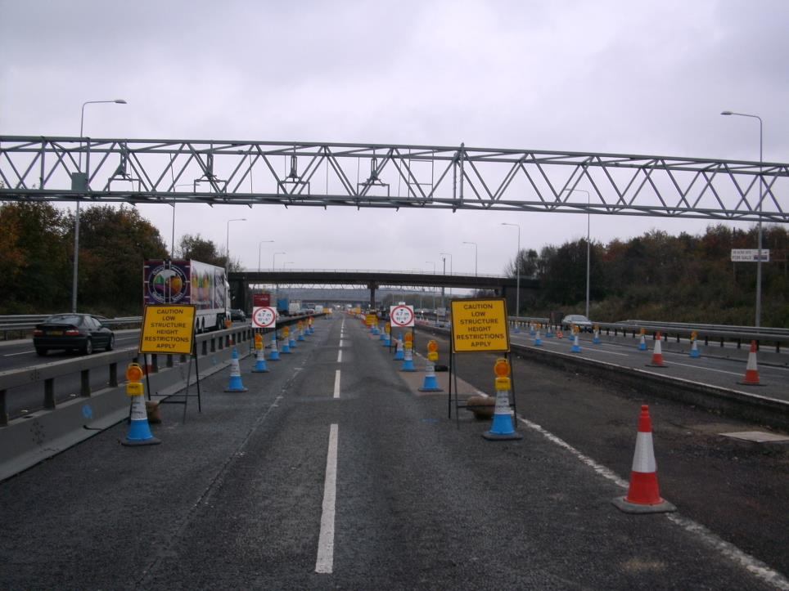
AFTER - OH protection in place from late Oct-09
Showing addition of 4.7m high max. travelling height signs
Notes:
Photo taken to show addition of 4.7m high max. travelling height signage, after completion of an exercise to determine max travelling heights of vehicular traffic and mobile plant equipment used in the construction area

Slide 13
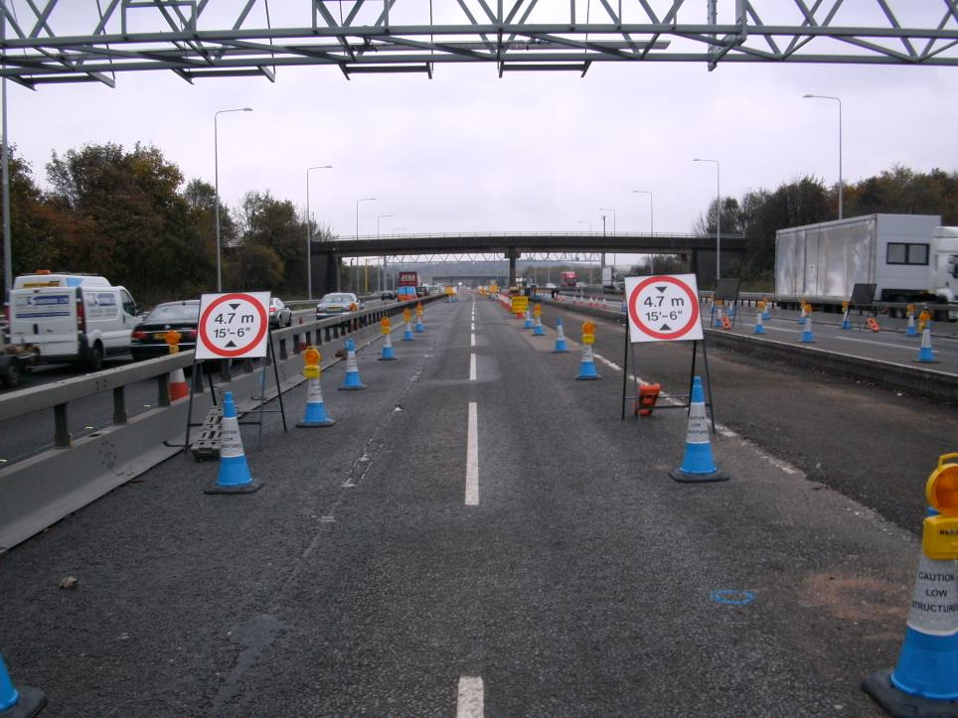
AFTER - OH protection in place from late Oct-09
Showing addition of 4.7m high max. travelling height signs
Notes:
Photo taken to show addition of 4.7m high max. travelling height signage, after completion of an exercise to determine max travelling heights of vehicular traffic and mobile plant equipment used in the construction area

Slide 14
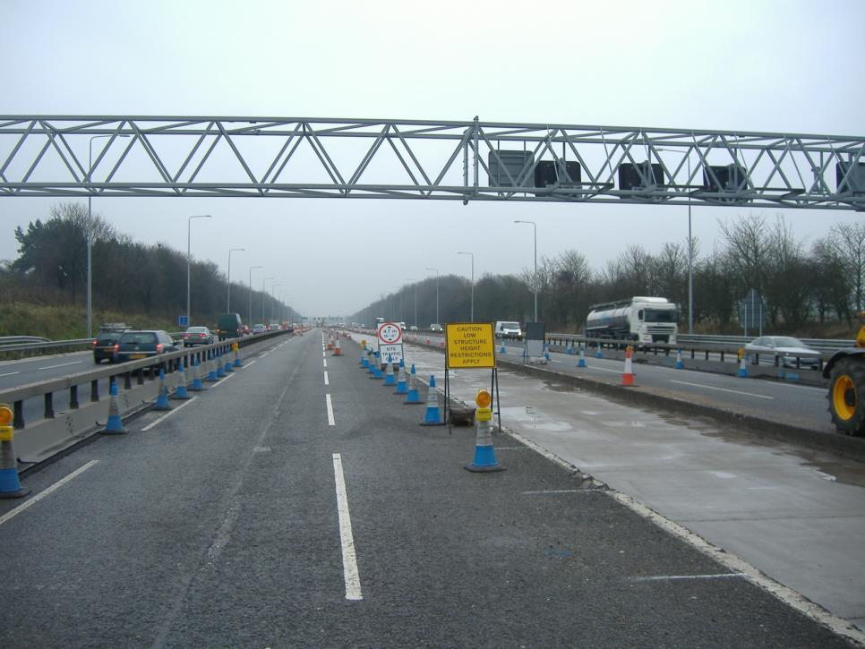
AFTER - OH protection in place from early Nov-09
Showing addition of site traffic only plate beneath the 4.7m high max. travelling height signs
Notes:
The “Site traffic only” sign was added to the 4.7m high max. travelling height signs following a HAIL received from a driver of a member of public vehicle. After travelling through this section of road works, the driver queried the 4.7m max. height restriction sign, asking if it referred to vehicles using the M1 Motorway (live lanes), because his vehicle, if fully loaded, could be in excess of this height. In response, the driver was advised that it was for use by site vehicular traffic only, hence posting of the additional sign plate.

